Slide 1
Java Basics

Slide 2
Disclaimer
Document Name:
Data Classification: CONFIDENTIAL
Disclaimer
The contents of this document are property of Softtek, and are classified as Confidential. Any reproduction in whole or in part is strictly prohibited without the written permission of Softtek.
This document is subject to change. Comments, corrections or questions should be directed to the author.
Audience/Viewership | Purpose
Java Beginners | Training
Revision Chart
The following chart list the revisions made to this document. Use this to describe the changes and additions each time this document is re-published. The description should be detailed as possible and include the names of the reviewers who request the changes.
Version No. | Version Date | Types of Changes | Owner/Author | Date of Review/Expiration
2 | 2019/01/23 | Update | Sarahi Flores | NA
1 | 2015/07/21 | Creation | Luis Robles | NA

Slide 3
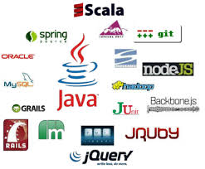
Lesson 1
Java Technology

Slide 4
What is Java?
Java is a programming language and computing platform
The Java programming language is a high-level language
Java is fast, secure, and reliable
Java is everywhere!
From laptops to datacenters, game consoles to scientific supercomputers, cell phones to the Internet.
The Java platform has two components:
The Java Virtual Machine: it's the base for the Java platform and is ported onto various hardware-based platform.
The Java Application Programming Interface (API): The API is a large collection of ready-made software components that provide many useful capabilities.

Slide 5
What is Java?
A programming language
An application environment
As a programming language, Java can create all kinds of applications that you could create using any conventional programming language.
Java technology applications are typically general-purpose programs that run on any machine where the Java runtime environment (JRE) is installed.
A development environment
A deployment environment
As a development environment, Java technology provides you with a large suite of tools:
A compiler (javac)
An interpreter (java)
A documentation generator (javadoc)
A class file packaging tool
and so on...
There are two main deployment environments:
The JRE contains the complete set of class files for all the Java technology packages, which includes basic language classes, GUI component classes, and so on.
Web browser. Most commercial browsers supply a Java technology interpreter and runtime environment.

Slide 6
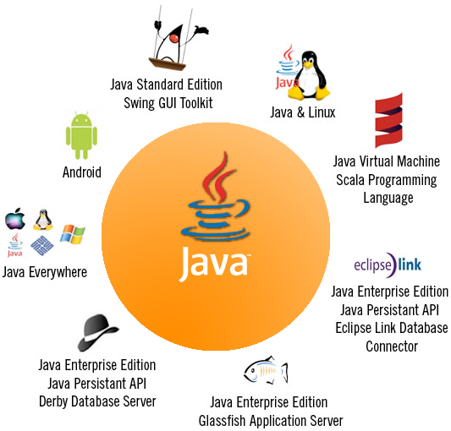
Characteristics
Java is a versatile, secure, portable and efficient platform, meet dynamic business needs and gives power to develop new innovative solutions which are platform independent and provide flexibility to face market challenges.

Slide 7
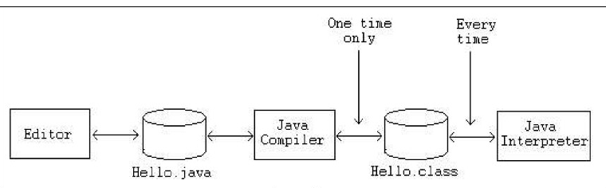
Phases of a Java Program
.java files are text files
.class files are Java bytecode files (source code compiled as binary file)

Slide 8
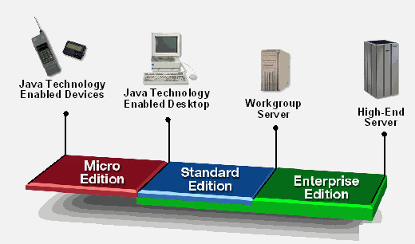
Java Platform
Java is generally thought of in terms of four platforms.
Standard Edition (SE) or JavaSE
Enterprise Edition (EE) or JavaEE
Micro Edition (ME) or JavaME

Slide 9







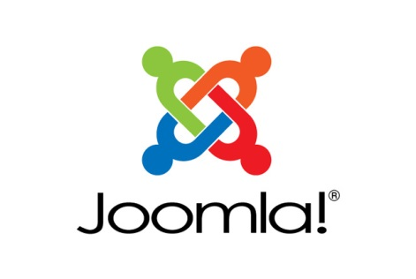


OpenSource/Commercial products
Some products based on Java

Slide 10
Virtual Machine and JDK
JRE
JDK
Java Virtual Machine (JVM) or Java Runtime Environment (JRE) is where all Java programs are executed.
Java Development Kit (JDK) is the compiler of java programs, JDK includes the JRE. But also includes a java library (classes) and command to compile and execute java programs.
A few of these commands are: java.exe, javaw.exe, javac.exe, javadoc.exe, javah.exe, etc.

Slide 11
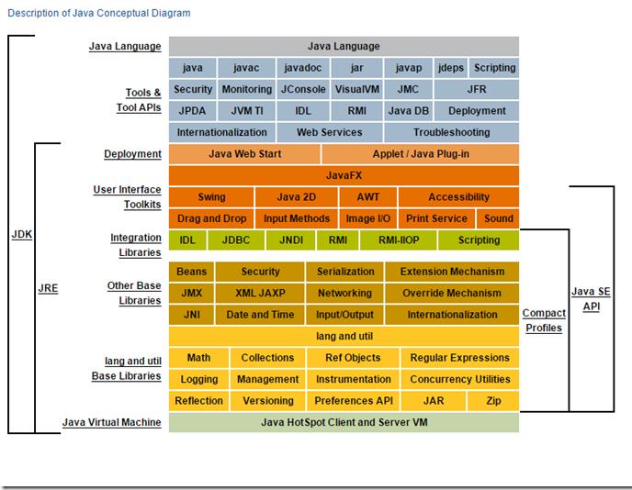
Java Platform
Java Conceptual Diagram (JavaSE 8)

